Slide 1
CSS3*
*It’s Cascading Style Sheets, with more cascadation!

Slide 2

CSS3
CSS is a style sheet language used to describe the look and formatting for HTML documents. CSS3 is a large, single W3C specification that defines a series of new features (called modules) that extend CSS2, as well as adding new capabilities.

Slide 3
Agenda
Border-Radius
Box-Shadow & Text-Shadow
Web Fonts
Media Queries
Transformations
Transitions and Animations

Slide 4
A Word about Vendor Prefixes
Keep an eye out for these in your CSS3 work:
“-moz-name” → Firefox
“-webkit-name” → Chrome & Safari
“-ms-name” → Internet Explorer
“-o-name” → Opera
And (almost) always list the non-prefixed version last.

Slide 5
Border-Radius*
*HTML5 *is* rounded corners, donchaknow?
Notes:
You’ll recall that semantics was one of our five words, because it’s important to understand why HTML5 introduces changes to the HTML5 markup specification, both by eliminating unneeded cruft and adding more semantically-rich elements.

Slide 6
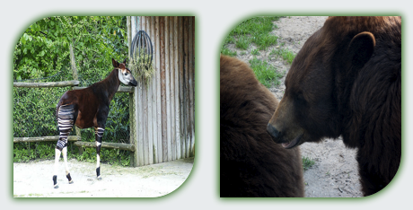
Rounding those Corners…
-moz-border-radius: 50px 0px 50px 0px;
-webkit-border-radius: 50px 0px 50px 0px;
border-radius: 50px 0px 50px 0px;
Notes:
We’ve been putting rounded corners on page elements for ages, but until recently, the only way we’ve been able to consistently create this effect in pages was with images. Now, the CSS Backgrounds and Borders module introduces a way to round the corners of your elements using only CSS, with the Border-Radius property. Note that this module, like many CSS modules, uses Vendor prefixes in some cases. IE and Opera don’t require the prefix, and newer versions of Chrome and Firefox don’t as well.

Slide 7






Browser Support for Border Radius
 |  |  |  |  | Mobile
9 | 4 | 3 | 10.5 | 3.1 | 9 | 2.1 | 3.2

Slide 8
Border-Radius
demo
Notes:
Let’s take a look at some of these new elements now.

Slide 9
Box-Shadow and Text-Shadow*
*Rounded Corners and Shadows? Design Done!
Notes:
Box-Shadow and Text-Shadow are two ways to use CSS3 to add drop-shadows to text and box elements. They are very similar, but operate on different elements.

Slide 10
Using Box-Shadow
-moz-box-shadow: 0px 0px 20px 5px #A9A9A9;
-webkit-box-shadow: 0px 0px 20px 5px #A9A9A9;
box-shadow: 0px 0px 20px 5px #A9A9A9;

Slide 11
Browser Support for Box-Shadow
 |  |  |  |  | Mobile
9 | 4 | 3.5 | 10.5 | 3.1 | 9 | 2.1 | 3.2

Slide 12


Using Text-Shadow
-moz-text-shadow: -1px 1px 1px #fff;
-webkit-text-shadow: -1px 1px 1px #fff;
text-shadow: -1px 1px 1px #fff;
/* Multiple Shadows */
text-shadow: 0 -2px 3px #fff, 0 -4px 3px #aaa, 0 -6px 6px #666, 0 -8px 9px #000;

Slide 13
Browser Support for Text-Shadow
 |  |  |  |  | Mobile
10 | 4 | 3.5 | 9.5 | 4 | ? | 2.1 | 3.2

Slide 14
Box-Shadow and Text-Shadow
demo
Notes:
Let’s take a look at some of these new elements now.

Slide 15
Web Fonts*
*Finally, Comic Sans is supported in the browser!

Slide 16

Using @font-face
@font-face {
font-family: 'SpicyRiceRegular';
src: url(‘spicyrice-regular-webfont.eot');
url('..spicyrice-regular-webfont.woff') format('woff'),
url(‘picyrice-regular-webfont.ttf') format('truetype'),
url(‘spicyrice-regular-webfont.svg#SpicyRiceRegular') format('svg');
font-weight: normal;
font-style: normal;
}
body {
font-family: "SpicyRiceRegular", Arial, Sans-Serif;
color: #343434;
min-width: 960px;
}

Slide 17
Browser Support for Web Fonts
 |  |  |  |  | Mobile
9 | 4 | 3.5 | 10 | 3.2 | 9 | 4 | 4.2

Slide 18
@font-face
demo
Notes:
Let’s take a look at using audio and video, and at how to provide fallback.

Slide 19
Media Queries*
*Mobile Targeting made easy

Slide 20
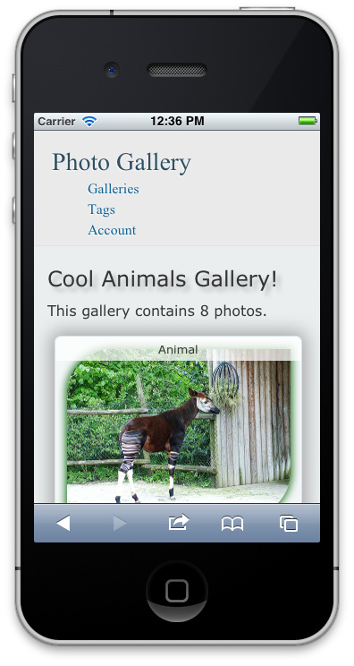
Working with Media Queries
body {
min-width: 960px;
}
@media screen and (max-width:1024px) {
body {
min-width: 480px;
max-width: 800px;
}
}
@media screen and (max-width:480px) {
body {
min-width: 120px;
max-width: 320px;
}
}

Slide 21
Browser Support for Media Queries
 |  |  |  |  | Mobile
9 | 4 | 3.5 | 9.5 | 4 | 9 | 2.1 | 3.2

Slide 22
Media Queries
demo
Notes:
Go to http://validator.nu/ and create a arbitrary attribute and try to validate the page
Append data- and attempt to validate again, it will work this time.
Now let’s look at real-world uses of data-. jQuery mobile makes heavy use of Data- attributes, and we can take a look and how we can query these
Go to jQueryMobile.com and show the gallery
Go to http://www.slideshare.net/mobile or m.opentable.com and open the Chrome Dev tools
Open the console and select an element by ID to show working with Data-* attributes

Slide 23
Transforms*
*CSS taking on some behavioral load
Notes:
CSS Transforms (2D and 3D) allow HTML elements to be rotated, resized, skewed and messed with in other ways.

Slide 24
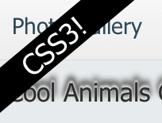
Using CSS3 Transforms
h2 {
-moz-transform: rotate(-40deg) scale(0.75) translate(-38%, -950%);
-ms-transform: rotate(-40deg) scale(0.75) translate(-38%, -950%);
-o-transform: rotate(-40deg) scale(0.75) translate(-38%, -950%);
-webkit-transform: rotate(-40deg) scale(0.75) translate(-38%, -950%);
background: black;
color: white;
text-align: center;
font-size: 3em;
}
Notes:
Rotate, scale and translare are among the most popular transforms available. Scale and transform-origin are two others.

Slide 25
Browser Support for Transforms
 |  |  |  |  | Mobile
9 | 4 | 3.5 | 10.5 | 3.1 | 9 | 2.1 | 3.2

Slide 26
Transforms
demo

Slide 27
Transitions and Animations*
*CSS taking on even more behavioral load
Notes:
Transitions and Animations are two different CSS3 modules, but they are often used together. These allow element properties to be animated via CSS, even with JavaScript is not available. Transitions are implicit and animations are declared, so transitions take effect when the property they are applied to changes value, while animations are explicitly executed when applied to an element. They have a lot of syntax in common.

Slide 28
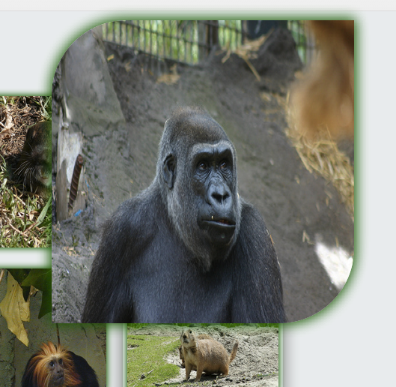
Using CSS3 Animations
img {
-webkit-transition: all 2s ease-in-out 250ms;
-moz-transition: all 2s ease-in-out 250ms;
-o-transition: all 2s ease-in-out 250ms;
-ms-transition: all 2s ease-in-out 250ms;
}
img:hover {
-webkit-transform: scale(2);
-moz-transform: scale(2);
-o-transform: scale(2);
-ms-transform: scale(2);
}

Slide 29
Browser Support for Transitions and Animations
 |  |  |  |  | Mobile
10 | 4 | 4/5 | 10.5/? | 3.1/4 | ? | 4 | 3.2

Slide 30
Animations
demo
Notes:
Let’s take a look at canvas and svg in action.

Slide 31
Questions?

Slide 32
Lab Instructions
Make sure you’ve cloned or downloaded the Labs repo from github.com/csell5/HTML5-Compiler
Go to http://bit.ly/x26I06 and follow the instructions from the readme
Alternatively, open readme.md in the “3- CSS3” folder

